Slide 1


Training on
“Tackling Climate Change in Agriculture: Approaches to Adaptation and Climate Smart Agriculture in the SADC Region”
Facilitation: Catalina Berger and Dr. Wiebke Foerch
Organiser: Shane Hardowar, University of Mauritius
18 – 22 June 2018
Réduit, Mauritius

Slide 2
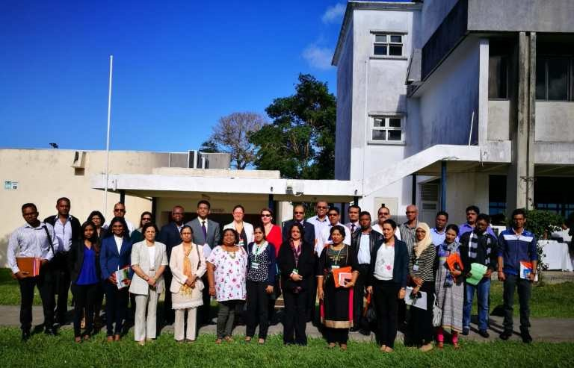
Our group

Slide 3
Programme
Monday | Tuesday | Wednesday | Thursday | Friday
Welcome and opening Presentation of participants Outline of the seminar Agenda | Presentation: CSA practices in Mauritius Presentation: Overview of Climate-smart Agriculture | Presentation: Nutrition-Sensitive Climate-Smart Agriculture Module A: Presentation of results | Recap of excursion Presentation: Strategies in sustainable intensification of livestock | Presentation: Carbon footprint in agriculture Presentation of the CP group work results
Presentation: Thematic introduction: Climate change, adaptation, mitigation Presentation: CC projections and impacts in SADC | Exposé: concept and steps of Climate Proofing Case study, Module A: Evaluating present and future vulnerabilities- current situation Action learning: risk functions | Action learning: dimensions of adaptation options Case study, Module B: Identifying adaptation options | Case study, Module C: Selecting adaptation measures | Feedback on CP approach Elaboration of action plans
Lunch break
Presentation: Agriculture - victim, culprit and potentials for adaptation and mitigation | Case study, Module A: Evaluating present and future vulnerabilities- future situation | Excursion to Plaine Magnien | Case study, Module C: Selecting adaptation measures – ctd. Presentation: Protected cultivation - an alternative for farmers | Presentation: CCARDESA‘s ICKM System Evaluation of training Certificates Closure
Presentation of case studies and composition of working groups | Presentation: Climate change and marine environment Presentation: Perception of CC by the Youth in Mauritius |  | Preparation of final presentations Presentation: CC with a value chain perspective

Slide 4
Objectives and participants
The overall objectives of the training were:
to train participants on the Climate Proofing (CP) approach with a focus on Climate Smart Agriculture (CSA)
to enable them to apply the concept in their individual working contexts
getting to know concepts of climate change adaptation and CSA for agricultural extension services
to enable the participants to apply such concepts in their extension work
to use feedback and lessons to further improve the training for future application in the region
Participants:
20 participants from agricultural extension services, research and the private sector
Country: Mauritius
Institutions: University of Mauritius UOM), FAREI (Food and Agricultural Research and Extension Institute), private enterprises
Gender balance: 8 women, 12 men

Slide 5
Day 1 - Overview
Welcome and opening
Presentation of participants
Presentation 1: Thematic introduction: climate change, adaptation, mitigation
Presentation 2: CC projections and impacts in SADC with focus on Mauritius
Presentation 3: Agriculture - victim, culprit and potentials for adaptation and mitigation
Presentation of case studies and composition of working groups

Slide 6
Day 1
During the opening ceremony, the welcome address was given by Mr. Shane Hardowar, Senior Lecturer at the Faculty of Agriculture (FoA) at the University of Mauritius (UOM). He welcomed the participants and the panellists to the training course.
The Dean of the FoA, Associate Professor Daneshwar Puchooa, welcomed and congratulated CCARDESA and the FoA for the upcoming training.
Subsequently, a welcome address and the launching was given by Professor Dhanjay Jhurry, CSK, Vice-Chancellor at the UoM.
This was followed by the keynote speech by Dr. Wiebke Foerch, GIZ-ACCRA programme on the “Regional Agricultural Policy – RAP”.
After the official opening the training began by a self-introduction of the course participants. During the presentation, participants had the opportunity to present themselves, their professional background, experiences with CCA and CSA as well as their expectations for the training course.
Key expectations raised were to gain more knowledge on CC adaptation (CCA) and mitigation strategies, to learn new tools and approaches, and to improve knowledge in CSA practices.
The thematic part of the course started with a presentation on climate change basics, by Catalina Berger, consultant. This was followed by presenting CC projections in SADC with a focus on Mauritius, by Prof. Sunita Facknath, FoA, UoM.
During a third presentation, participants learnt about the role of the agriculture as victim and culprit of climate change at the same time. The presentation was given by Dr. Wiebke Foerch.
The day was closed by the presentation of the case studies and the composition of working groups for the Climate Proofing (CP) approach.

Slide 7
Welcome Address by Shane Hardowar,
Senior Lecturer, FoA at the UoM
Mr. Hardowar, initiator and main organiser of this training course, warmly welcomed the participants and the panellists to the opening session of the five days Climate Proofing and CSA training.
He mentioned the objectives of the training, namely to understand the Climate Proofing tool and to get familiar with the Climate Smart Agriculture (CSA) approach.
Further, Mr. Hardowar thanked the Centre for Coordination of Agricultural Research and Development for Southern Africa (CCARDESA), the Dean of the UOM as well as all the presenters who prepared presentations for the week’s training.

Slide 8
Address by Associate Professor Daneshwar Puchooa, Dean of the FoA, University of Mauritius
Associate Professor Daneshwar Puchooa welcomed and congratulated CCARDESA and the FoA for the upcoming training. He underlined that the Food and Agriculture Organisation (FAO) stated that the agriculture sector undergoes changes and challenges to feed an increasing world population and to ensure food security worldwide. Climate Change (CC) exacerbates and reduces agricultural production, but CSA is one key to globally increase the agricultural production.
The FoA responded to this challenge through the governments’ policy and incorporated Adaptation to CC. Another key to increase production lies in the domain of agri-science and technology. The FoA therefore strives to prepare their graduates for the science and private sector and updates its programmes to meet the needs. Further, the FoA embarked on the challenges of CC and CSA to support the agricultural sector to combat CC and to better adapt. In cooperation with the FAO, programmes on CSA have been developed. To further improve the performance of the sector, bio-agriculture is prompted in Mauritius. The Dean expressed the expectation that the CP training will enhance capacity building. He thanked CCARDESA and Mr. Hardowar, who make this training happen and reminded the audience that agriculture and land use change are a prominent source of greenhouse gases (GHG) and urged to look for opportunities to mitigate these. He concluded his address with a citation of Emmanuel Macron, President of France: “Let us face it, there is no planet B.”

Slide 9
Welcome address and launching by Professor Dhanjay Jhurry,
CSK, Vice-Chancellor of the UoM
Prof. Jhurry welcomed everybody to the workshop and stated that CC is a reality and a major cause of concern, not only in the agricultural sector, but also in the public and private sector. During the Conference of the Parties (CoP) 21 at Paris, the first binding agreement to reduce GHG has been negotiated by the parties (Paris Agreement).
CSA is recognized as crucial to increase food productivity. The FAO acknowledges the importance of CSA. Both adaptation to CC and also mitigation strategies to reduce Greenhouse Gases (GHG) require enabling policies, but there are still barriers for adaptation, e.g. correlated to social aspects.
Prof. Jhurry reminded the audience that the world needs to shift to a more sustainable use of resources to reduce GHG and thus protect the biodiversity of the planet. This asks for more investment for research and development. Food supply chains also need to be linked to urban markets and require a sound price policy. Capacity building is needed to effectively respond to these challenges. The UoM already stablished poles for bio-farming and CSA. The private sector, academia and research are needed to look for CSA technologies and to join forces.
He is looking forward to working together on these important topics and wishes a fruitful training.

Slide 10
Keynote speech by Dr. Wiebke Foerch,
GIZ-ACCRA programme
Dr. Wiebke Foerch, Advisor at the Deutsche Gesellschaft für Internationale Zusammenarbeit (GIZ) programme on Adaptation to Climate Change in Rural Areas (ACCRA) gave the keynote speech on behalf of Dr. Simon Mwale, Acting Executive Director of CCARDESA who could unfortunately not attend.
She started her presentation with a situational overview of the SADC region with respect to CC, stating that the region is extremely vulnerable to CC. Esp. the agricultural sector, which comprises 70% of the work force, is affected. Climatic conditions is SADC are getting harsher and more unpredictable, extreme weather events (droughts, heavy rainfall etc.) are increasing.
SADC Regional Policy Frameworks were developed to address CC in a strategic manner. These frameworks comprise the:
Revised Regional Indicative Strategic Development Plan 2015-20
Comprehensive Africa Agriculture Development Programme (CAADP)
SADC Regional Agricultural Policy (RAP)
SADC Regional Agricultural Investment Plan (RAIP)
Wiebke explained the RAP more in detail, which’s overall objective is the contribution to sustainable agricultural growth and socio-economic development in SADC. CC is covered under Specific Objective (iv) of the RAP - Reduce social and economic vulnerability. RAP recognises effects of droughts, floods and temperature change on the agriculture sector.
She concluded her keynote speech by presenting CCARDESA as the implementing organisation for the Comprehensive Africa Agriculture Development Programme (CAADP) and CCARDESA’s mandate to coordinate agricultural research and development in the SADC region.

Slide 11
Presentation 1: Climate Change, adaptation and mitigation by Catalina Berger, consultant
The thematic introduction elaborated about climate change in general and adaptation and mitigation in particular.
It started with the explanation of the term mitigation, which is determined as emission saving/reducing measures. The presenter also explained sources of Greenhouse Gases (GHG) as well as the most important GHG who contribute to global warming.
The main sectors of anthropogenic GHG emissions are the energy sector (66%) and land use change/ agriculture (26%). Signals of climate change are sea level rise, change in temperature and precipitation patterns. The impact chain of the climate signal “sea level rise” was explained from loss of land to bio-physical and socio-economic impacts.
To manage the unavoidable, adaptation is needed to adjust to actual or expected climate and its effects. Both mitigation and adaptation are complementary strategies for a climate-compatible development.
The presenter reminded the audience that the Climate Proofing training focuses on adaptation measures, but that the mitigation potential of adaptation measures will also be determined.
The presentation concluded with the basic definitions on weather, climate, climate variability and climate change to make participants understand the terminology and differences.

Slide 12
Q&A
How were levels of GHG concentration pre-industrialisation determined?
  Through proxy indicators – permanent ice in the arctic is drilled and in these cores, concentrations of GHG at different points in time can be determined in the lab
Is the concentration of GHG in the atmosphere the same across the globe?
  Yes, more or less – though volcano eruptions, etc. have an effect
  Measures in the observatory in Hawaii
What makes CO2 retain heat?
  Physical barrier. The sunrays touch the earth, get reflected back as heat but can not radiate back into the universe
Are there any countries that have zero emissions?
  No, all countries have some level of agriculture, transport or industrialisation
  In most countries emissions per capita have been increasing (an example of reduced emissions was in eastern Germany after reunification due to closing of coal mines, etc. – but this has reversed again)
Implications of population growth
  Depends on context – countries like Niger have high population growth but low level of economic development – impossible to discuss – Versus China, there is more awareness and measures in place to reduce emissions – shift in economy is slowly trying to happen, but a question of resources and power – BUT China still argues the emissions per capita position at UNFCCC (total emissions per country high in China, but in terms of per capita emissions in China are low)
How do we measure emissions?
  Carbon dioxide equivalent – the different GHG have different potencies, being compared to CO2 – this is now also being converted into the carbon footprint
Sea level rise has a lot of effects, not just on land loss and biodiversity on land but also on marine ecosystems
Mitigation – a good example of complementary benefits with adaptation is the use of biodigesters where emissions are saved, as well as adaptation achieved
Notes:
-

Slide 13
Presentation 2: CC projections and impacts in SADC with focus on Mauritus by Prof. Sunita Facknath, FoA, UoM
Prof. Facknath reminded that Southern Africa has always been among the regions in the world most affected by extreme shifts between droughts and floods. The region is expected to experience higher land and ocean surface temperatures, which will affect rainfall, winds, and the timing and intensity of weather events. These changing parameters have severe impacts on agriculture and food production, e.g. changes in crop phenology, reduced crop and animal yields, increase in pests and diseases, reduction in soil health and fertility. To respond to these impacts, SADC has developed and is coordinating a weather and climate monitoring programme. In 1990, the SADC Climate Services Centre (CSC) was created with the main objective to reduce negative impacts from climate extremes, such as droughts and floods. CSC generates medium-range and long-range climatic outlook assessments that are disseminated to all Member States. Early Warning Units were established in 12 Member States to collect, analyse, and disseminate early warning information covering seasonal rainfall and crop development, harvest forecasting, import and exports, food stocks, price and market monitoring.
On CC in Mauritius, the presenter stated that average temperatures have risen by 0.74°C over mainland, compared to the 1961-90 mean. Rainfall is becoming more erratic and the overall precipitation has decreased by 8% (1950 and 2008). The frequency of extreme events is increasing and cyclones are intensifying much faster. Between 1998 and 2007, the local mean sea level rose by 2.1mm per year. Regional impacts observed are the droughts in 1999 and 2011, flash floods in 2008 and 2013, coral bleaching and accentuated beach erosion. In order to address climate change, the Republic of Mauritius is developing a pragmatic approach to develop its resilience. Mauritius is developing an early warning system that will give three days notice of possible storm surges and improving its capacity to evacuate people from vulnerable areas.
CSA is the key to enhance agriculture productivity under changing climatic conditions. The presenter gave examples of CSA related activities and studies elaborated by the Faculty of Agriculture.

Slide 14
Q&A
Global risks report 2018. Download path for the report: http://www3.weforum.org/docs/WEF_GRR18_Report.pdf
Study on climate smart technologies for Rodrigues – targeted at farmers, have a look
Are there existing studies on the impacts of climate change on specific value chains and crops?
  Yes, within the faculty and beyond
  There is no one place to find all the available studies – it would be good to check directly with the climate centre which exists for this purpose – though we are lacking an effective mechanism to collect newest information from research
  Link to the CSC:
  https://www.sadc.int/sadc-secretariat/services-centres/climate-services-centre/
Notes:
-

Slide 15
Presentation 3: Agriculture - victim, culprit and potentials for adaptation and mitigation by Dr. Wiebke Foerch, GIZ
Wiebke summarized the effects CC will have on agriculture, whereby she stressed that the sectors suffers from CC but at the same time also contributes to global warming (by the release of GHG). Ca. 10% of the global GHG emissions are stemming from the agricultural sector (soil, fermentation, rice cultivation, energy, manure management and other) and 14% from the change of land use.
She then presented an overview on different types of ecosystems and their CO₂ storage capacity. It became clear that not only tropical forests but also cold temperate forests and grasslands store large quantities of carbon. Wetlands have got the highest CO₂ concentration in their soils.
Examples for mitigating GHG in agriculture and land use change were shown, amongst them tree planting, appropriate fertilizer application, planned land use change, reducing post harvest losses and food wastage.
Adaptation in agriculture is a multi-dimensional and multi-level process from farm to community to the public level. Wiebke illustrated each level with examples and closed with criteria for sustainable agriculture.

Slide 16
Q&A
- Synergies between adaptation and mitigation: when you say measure, some adaptation measures are costly, so we better go with mitigation? Adaptation is costly
It depends on the context. Sometimes in drylands it is difficult to mitigate and create a co-benefit. It comes down to context. We need to adapt to make the systems more resilient. There is no one solution which fits in all problems/regions. Also not in the same systems of interest in different countries. Climate proofing is the tool to find the best adaptation options.
- We need to do something about population growth! Adaptation is the main focus, but we must look at each case different
The issue of population growth can be debated in all kinds of settings. For example Ethiopia had an increase in its population from 20 mio in the 1980s to 100 mio now. Esp. if you combine it with consumption patterns, it becomes a big challenge.
- Maize/coffee cultivation: shrinkage of suitable area can be attributed to CC. Overuse of fertilizer and pesticides. How to stabilize an ecosystem? With CSA or conventional agriculture?
It is clear, that CC does change suitability of crops in certain areas. In many parts of the globe we are operating in systems which are not sustainable. We need to use our resources more sustainable. CSA: it brings the climate element in the center of the debate. A lot of overlap. Maize as a C4 crop will not perform any more above a certain temperature. You see it with a lot of staple crops in the region (temperature and rainfall as main parameters). Coffee only grows in a certain altitude and under a certain temperature regime.

Slide 17
Presentation of case studies and composition of working groups
Four case studies were prepared beforehand by the Food and Agricultural Research and Extension Institute (FAREI) and Mr. Shane Hardowar to work on through the Climate Proofing approach.
Livestock
Litchi
Tomato
Potato
Each participant was asked to choose the one case study he/she is most interested in.
Finally, the case studies on livestock, litchi and tomato were chosen to be climate proofed. Equally numbered sub-groups of 6 participants per case were formed.

Slide 18
Day 2 - overview
The day started with the presentation of Shane on “CSA practices and technologies with a focus on Mauritius” and was complemented by an “Overview of Climate-smart Agriculture” held by Wiebke
This was followed by an exposé about the Climate Proofing approach and an explanation about the objectives, steps of implementation as well as the modules covered during the training.
Afterwards, the three sub-groups started to work on Module A of the case work, which is split into two parts. The group work started with part 1: Assess the risk – current situation
The following action learning introduced the risk terminology as it is used according to the 5th Assessment Report of the IPCC
The groups worked through Part 2: Assess the risk – future situation
The group work was followed by two presentations: the first one was on the “Impacts of CC on marine systems” by Dr. Satyam Bhoyroo, the second one about the “Perception of CC by the Youth in Mauritius” by Julia Carpouron

Slide 19
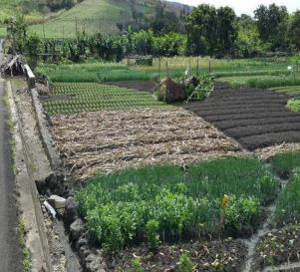
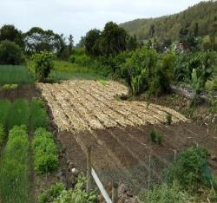
Presentation 4: CSA practices and technologies in Mauritius, by Shane Hardowar, FoA
Shane started by giving the FAO’s definition of CSA : CSA sustainably increases productivity, resilience (adaptation), reduces or removes GHGs (mitigation) and enhances the achievement of national food security and development goals (development).
The FAO calls these the three pillars of CSA. CSA promotes best practices such as crop rotation, mulching, integrated crop-livestock management, conservation agriculture, improved grazing and improved water management, intercropping, improved seeds and fertilizer management practices.
Shane then presented past projects and research done on CC and CSA in Mauritius followed by an overview of adaptive and CSA measures practised by Mauritian farmers. Among these he cited techniques like Conservation Agriculture (soil conservation, soil and nutrient management), water harvesting, crop diversification, intercropping and mixed cropping, improved seeds and feeds, irrigation system and use of traditional knowledge. On a lot of these examples he showed pictures taken in various regions of Mauritius.
Mixed cropping
Mulching

Slide 20
Q&A
A lot of these practices we are already doing – so what is climate smart and what is not?
  Yes, this is a struggle – we are already doing it….
  We need to define what modern CSA systems in Mauritius are and what technologies are included
  There are also indigenous practices that are adaption options
Can we have a list of what CSA practices are?
  No, because these practices are always context-specific, but there is a whole portfolio of CSA practices which will work in different places
  No silver bullet and no blue print
  There are limitations of practices also in terms of costs, for example
Do we know the costs of shifting to CSA?
  No, we need to undertake cost benefit and feasibility analyses to make the case for certain CSA practices in specific locations
How do we deal with the slow onset of profit – some practices take time to bear fruit?
  Yes, this is difficult – need to look at longer time frames to strengthen sustainability
  Need a range of stakeholders involved and need institutional support

Slide 21
Presentation 5: CSA overview by Dr. Wiebke Foerch, GIZ
Productivity
Wiebke presented the challenges for agriculture by 2050, namely to double world food production on the same amount of land, make farms, fields and landscapes more resistant to extreme weather, while massively reducing GHG.
Goals of Climate-smart Agriculture
Adaptation
Mitigation
These challenges can be targeted with CSA, the presenter gave an overview of the CSA portfolio of concepts and technologies. But also CSA faces many challenges, like many different practices, many goals and also many contexts in which to apply the practices. She explained, that many practices can be CSA somewhere, but none are likely CSA everywhere.
Wiebke then gave an overview of CSA in different sectors: soil and water conservation, agroforestry, (post) harvest losses and food losses, indigenous varieties/breeds, integrated pest management and biological pest repellents, agricultural risk insurance.
On every topic she showed examples and more in-depth information.

Slide 22
Q & A
What is Coppicing? A traditional method of woodland management which exploits the capacity of many species of trees to put out new shoots from their stump or roots if cut down. (Source: Wikipedia)
What is wind winnowing? An agricultural method developed by ancient cultures for separating grain from chaff. It is also used to remove hay and chaff or other pests from stored grain. Threshing, the loosening of grain or seeds from the husks and straw, is the step in the chaff-removal processed into the air so that the wind blows away the lighter chaff, while the heavier grains fall back down for recovery. (Source: Wikipedia)
- For the farmers it is not profitable to pay people for harvesting and to carry yields to local markets. Market prices are very low.
CSA does not operate in a vacuum. Think beyond in the value chain and marketability of crops
- How to take agricultural risk insurance? Smart is in the center. Productivity and mitigation/adaptation can be overlapping.
Study from C. Lamanna (World Agroforestry Center) provides evidence, which practices are climate smart. Agroforestry can give you better yields in one, but not in the other setting. Context-specific, which is a challenge. More evidence (CBA, feasibility studies) are needed. We know enough about the options, to know which are robust and are likely to be good.
- The micro-climates in Mauritius is a challenge.
A key challenge for adoption of CSA. There is a certain risk for the farmer involved.

Slide 23
The Climate Proofing approach – Introduction and steps

Slide 24
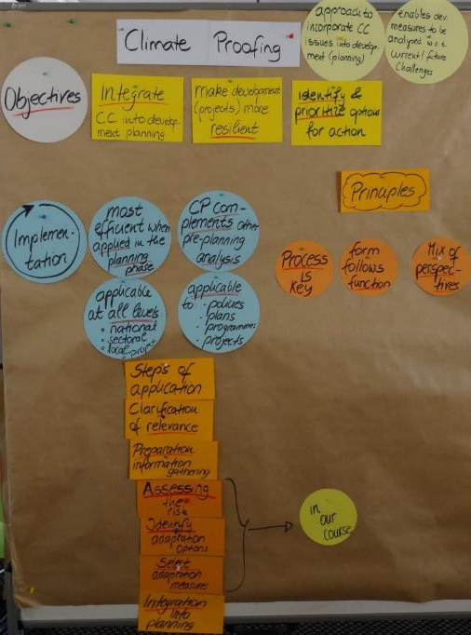
Introduction: the Climate Proofing approach
Climate Proofing:
A methodological approach aimed at incorporating issues of climate change into development planning. It enables development measures to be analysed with regard to current and future climate challenges and opportunities presented by climate change.
http://www.saaiks.net/blog/mshare_ressource/tackling-climate-change-in-agriculture-approaches-to-climate-change-adaptation-and-climate-smart-agriculture-in-southern-africa/

Slide 25
Module A
Assess the risk Part 1: current situation
Learning objectives:
Analyse the current risks and additional challenges caused by climate change in a defined system of interest
Identify and handle the different factors contributing to “risk” in a system: sensitivity, adaptive capacity, basic vulnerability, hazard, exposure, and potential impacts
Define the need for action according to the projected risk (the probability of climate hazards and the extent of damage) in the system
Steps:
Discuss within your group the system of interest: the exposure unit you will assess during the training.
List up to five key actors of the system of interest and also explore their roles and responsibilities.
Explore further key elements of the system such as social, technical or natural components and give an estimate of their actual status quo on the tendencies.

Slide 26
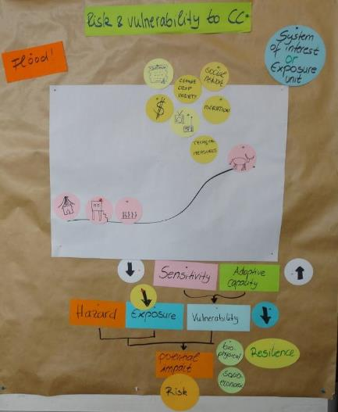
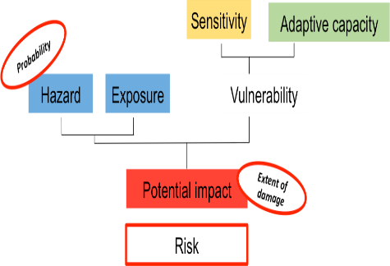
Action learning
Risk function
IPCC 2014

Slide 27
Risk: The potential for consequences where something of value is at stake and where the outcome is uncertain, recognizing the diversity of values. Risk is often represented as probability of occurrence of hazardous events or trends multiplied by the impacts if these events or trends occur. Risk results from the interaction of vulnerability, exposure, and hazard. In this sense, the term risk primarily refers to the risks of climate-change impacts.
Hazard: The potential occurrence of a natural or human-induced physical event or trend or physical impact that may cause loss of life, injury or other health impacts, as well as damage and loss to property, infrastructure, livelihoods, service provision, ecosystems and environmental resources. In the IPCC AR5 report, the term hazard usually refers to climate related physical events or trends or their physical impacts.
Exposure: The presence of people, livelihoods, species or ecosystems, environmental functions, services and resources, infrastructure or economic, social, or cultural assets in places and settings that could be adversely affected.
Vulnerability: The propensity or predisposition to be adversely affected. Vulnerability encompasses a variety of concepts and elements including sensitivity or susceptibility to harm and lack of capacity to cope and adapt.
Sensitivity: The degree to which a system or species is affected, either adversely or beneficially, by climate variability or change. The effect may be direct (e.g., a change in crop yield in response to a change in the mean, range, or variability of temperature) or indirect (e.g., damages caused by an increase in the frequency of coastal flooding due to sea level rise).
Adaptive capacity: The ability of systems, institutions, humans, and other organisms to adjust to potential damage, to take advantage of opportunities, or to respond to consequences.
Adaptation measures can 1. reduce sensitivity, 2. increase coping & adaptive capacity (and 3. potentially reduce exposure)
Risk function
Definitions

Slide 28
Module A
Assess the risk Part 2 - future situation - I
Identify the key climate related hazards (observed & projected) of concern to which the system might be exposed. If possible, also note the frequency to which the system might get exposed to these signals.
Consider next, if and how the system of interest’s actors and assets are sensitive to climate hazards. Think of ecological and social sensitivity. Relate your assessment to the condition and trends of the system of interest. Take into consideration the actual situation and possible developments in the system (part 1).
Note down the system’s current adaptive capacity that would increase the adaptive capacity of a community. What is the adaptive capacity of institutions to support climate adaptation? Are national or local governments and organisations supporting planned adaptation?
Now brainstorm the potential impacts of the climate related hazards to the system of interest.
  First brainstorm the potential impacts to the biophysical part of the system by considering hazard in combination with the vulnerability factors.
  Then brainstorm socio-economic impacts, resulting from the biophysical impacts.

Slide 29
Module A
Assess the risk Part 2 - future situation - II
In the last column, assess the probability of hazard and the extent for every potential biophysical and socio-economic impact. Discuss the column using the following questions:
  How relevant are the potential impacts to the development objective?
  Define a time horizon according to the objective of your analysis
  How likely is the impacts’ occurrence?
  What is the extent of expected damage?
  Asses the level of risk (low, medium, high) of each impact by combining the likelihood of each biophysical impact with the severity of its socio-economic impact.

Slide 30
Module B
Identifying adaptation options
Task : Brainstorming “What could be done to respond to the challenges in order to be able to meet the development objective(s)?”
Find the selection of impacts you have rated as “high risk” from the previous module.
Brainstorm as many adaptation options as possible per impact to reduce the risk of climate change
Add adaptation options from policy, capacity development, technical or research
Finally, note as main actors whose contributions are necessary to implement the adaptation options.
Before the group work started, the facilitator led the participants through an action learning exercise on different levels and types of adaptation options (see next slide)

Slide 31
Levels and types of adaptation measures

Slide 32
Module C:
Select adaptation measures
Agree on the set of selection criteria
Discuss each option using the criteria and score them by using 1 – 5.
Do the overall score
If too many options have similar evaluations, try to be more specific by introducing another criterion or weighting the criteria.
Add an estimation of the mitigation potential for each measure

Slide 33
For a consistent overview, the results of the Climate Proofing exercise of the three cases studies are grouped together per case.
Climate Proofing of 3 agricultural systems

Slide 34
Results Case 1: Livestock
Livestock

Slide 35
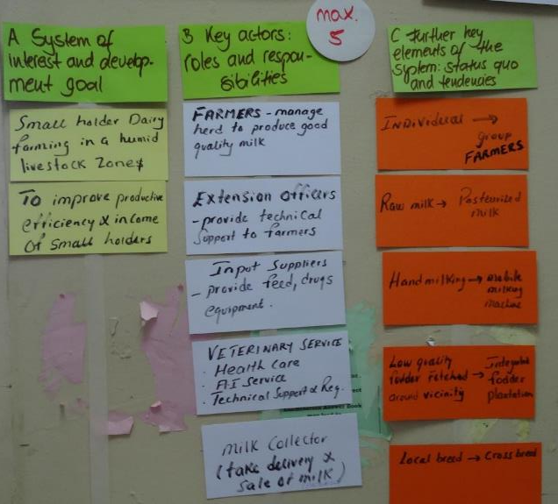
Module A – current situation
Case 1: Livestock

Slide 36
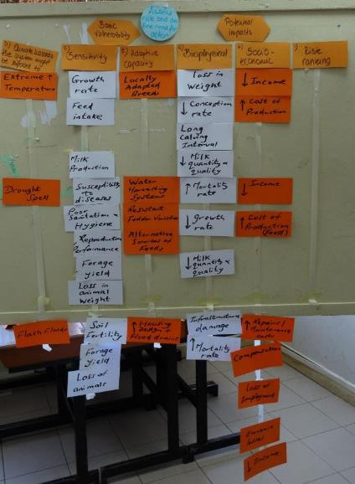
Module A – future situation
Case 1: Livestock

Slide 37
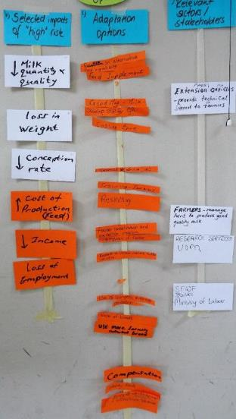
Module B
Case 1: Livestock

Slide 38
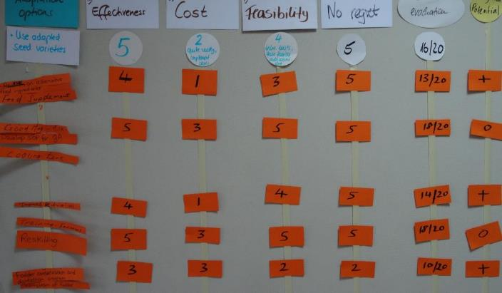
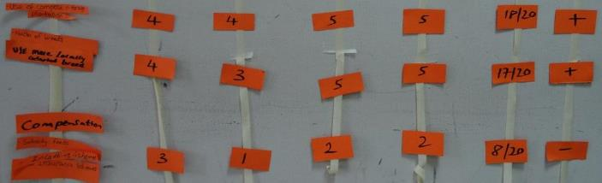
Module C Case 1: Livestock

Slide 39
Presentation of final adaptation measures Livestock

Slide 40
Project
Small holder dairy farming in a humid livestock zone
Presentation from Livestock team

Slide 41
Outline
Profile of dairy system of interest
Development Goal
Climate Proof Tool
Potential Climate Hazards
Adaptation Options identified
Concluding Remarks

Slide 42
Profile of dairy system of interest
Project site: Melrose
Livestock zone set up in state Land (approximately 40 acres)
Regroup 10 farmers (10 units)
10 cows (locally adated cross breeds) per unit – confined/cut and carry system
Each unit 4 acres (0.5 acres for farm building)
Integrated fodder unit (fodder grasses and legumes) of 3.5 acres per farm
Target: 1000 litres per day
Sale: pasterised milk to middlemen

Slide 43
Development goal
To improve productive efficiency and income

Slide 44
Climate Proofing Tool used
Steps followed:
Current and future climate risks assessed
Adaptation options identified and
Adaption measures selected

Slide 45
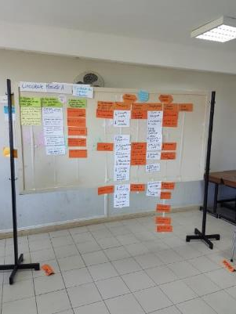
Potential Climatic Hazards
Extreme high temperature
Flash floods
Drought

Slide 46
Potential Impacts
Extreme high temperature Flash floods Drought | Decrease in Milk quantity and quality Animal performance (loss in weight, conception rate, long calving interval) Increase in mortality rate Damage to infrastructure Decrease in Milk quantity and quality Animal performance Increase in mortality rate | Decrease in income and increase in cost of production

Slide 47
Risk Assessment
After observing the climate hazards, basic vulnerability and potential impacts, the risk rating was medium

Slide 48
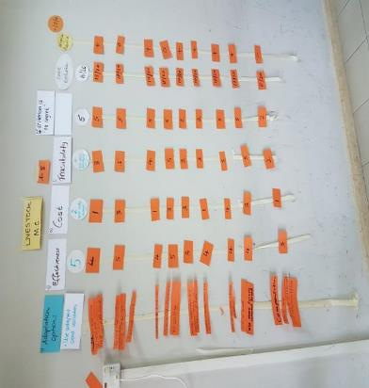
Adaptation Options
11 adaptation options identified

Slide 49
Adaptation Options Identified
Adaptation Option | Overall Evaluation (/20) | Mitigation Potential
Good milking practices | 18 | 0
Use of cooling tanks | 18 | 0
SOP for Quality assurance | 18 | 0
Training of farmers/reskilling | 18 | 0
Use of compost in forage plantation Use of locally adapted cross breeds | 18 17 | + +

Slide 50
Adaptation Options Identified
Adaptation Option | Overall Evaluation (/20) | Mitigation Potential
Improved AI Service Research on alternative feed ingredients/feed supplements Fodder conservation and germplasm | 14 13 10 | + + +
Research on use of climate-resilient fodder varieties | 10 | +
Policy measures (compensation, insurance, etc) | 8 | -

Slide 51
Concluding Remarks
5 options have equal rating of 18/20
Out of these 5 adaptation options only one shows mitigation potential
Policy measures (compensation) give a low overall rating and –ve mitigation potential
Out of 11 options, two adoption options have regret measures
Climate Smart Project (P,R,M)
Overall, the proposed project with the adaptation measures meet our development goal
Resilience
Mitigation
Productive

Slide 52
Thank You

Slide 53
Q & A
Final presentation Livestock
Normally in these CP contexts, would we get a different result if we talk to farmers? It is crucial that this is done with farmers because obviously this is now skewed towards what researchers perceive as important options
Mitigation potential – this is based on best knowledge available in the group at the moment – important to maintain scientific rigour and make sure we have the evidence to support this
Local context matters. We need to bring local knowledge into the picture, to complement the scientific perspective
Mitigation potential: how do you get a positive mitigation potential through research activities? Think about the research, not necessarily the adoption of the research outputs
Negative mitigation potential of policy measures – it is just a short term solution then farmers go back to their old practices, to business as usual
Need more detail on your adaptation options – lacks elaboration
  Need good milking practices to maintain high milk quality and avoid quality loss, especially under high temperatures this is critical – plus associated costs of implementation are minimal
So which option to pick?
  We need a portfolio of a few options which are synergetic with a higher probability of success, if in combination
Policy incentives – these are primarily compensation of farmers after climate hazard have resulted into impacts
Expensive options – research measures rather than adoption – research trials have to be implemented in the long-term and require the testing of new technologies
Mitigation
  Cooling (neutral) – requires energy …..
  AI (positive) – focused on locally adapted breeds and improving the process

Slide 54
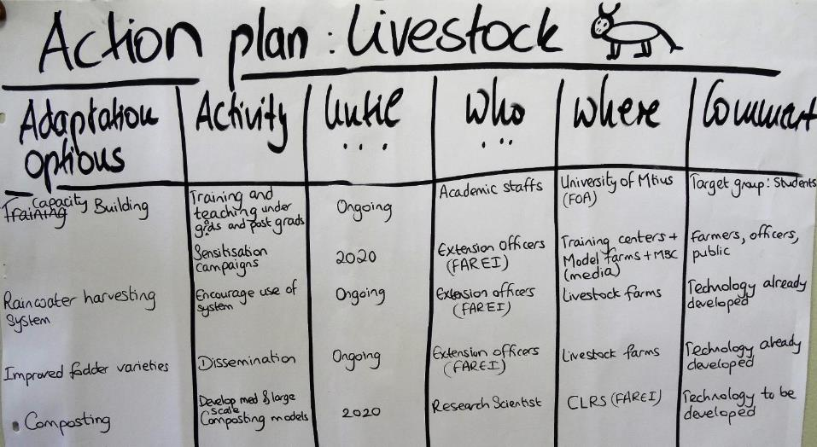
Action plan
Case 1 Livestock

Slide 55
Results Case 2
LITCHI

Slide 56
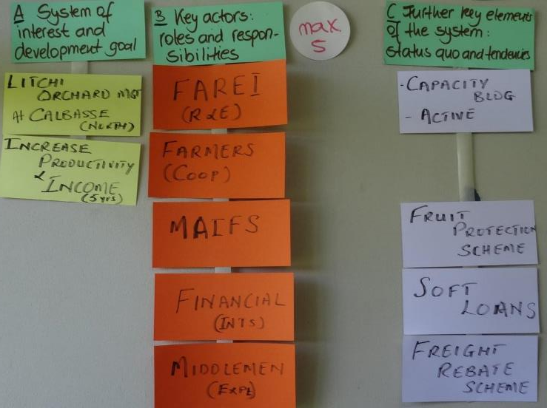
Module A.1 – current situation
Case 2: Litchi

Slide 57
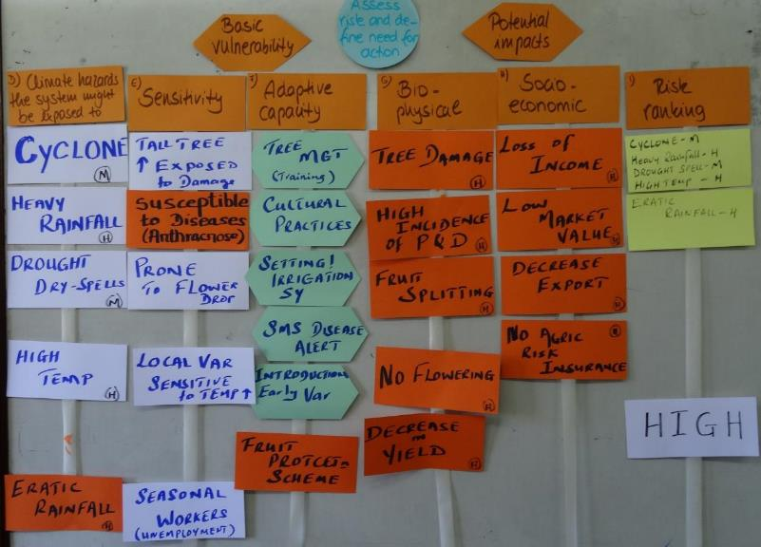
Module A.2 – future situation
Case 2: Litchi

Slide 58
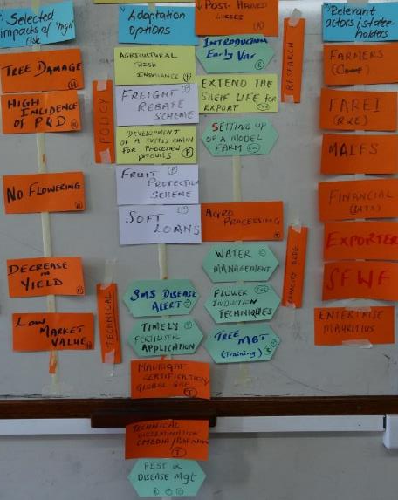
Module B
Case 2: Litchi

Slide 59
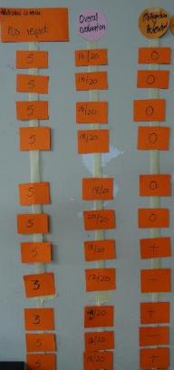
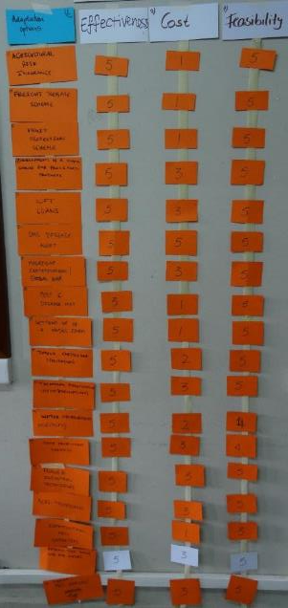
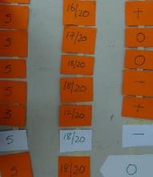
Module C - Case 2: Litchi

Slide 60
Presentation of final adaptation measures Litchi

Slide 61
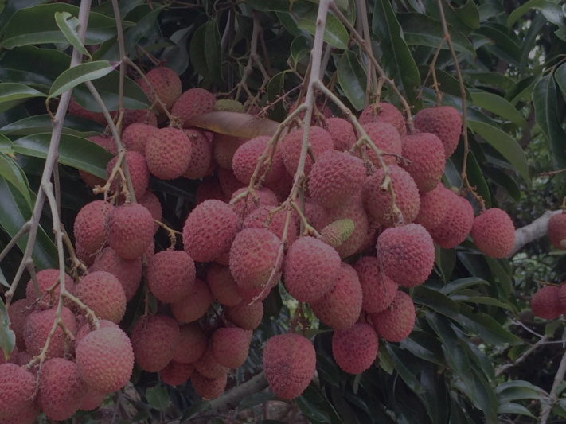
“Tackling Climate Change in Agriculture: Approaches to Adaptation and Climate Smart Agriculture
Group Litchi
22th June 2018

Slide 62
Litchi Orchard Management at Calebasse in the North
System of Interest
22th June 2018

Slide 63
Sustainable Development Goal
To increase productivity and income over a period of five years

Slide 64
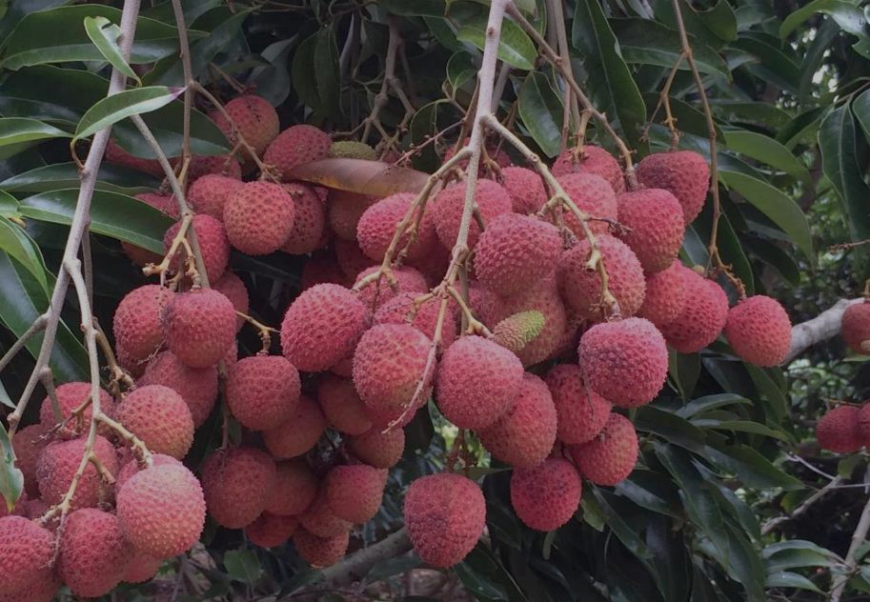
Litchi Production in Mauritius
Litchi first reported in Mauritius in 1763
Litchi introduced during the French colony (1715-1810) from China
In 1929, during the British colony, varieties Sun Yat Sen,Green, Rose scented and Kafri were brought from India
First litchi export to London in 1934 till 1939
Export of litchi gain economic importance as from 1969
From 1984 to 1990, 120 tonnes of litchi were exported annually
After 1990 the export continued to rise

Slide 65
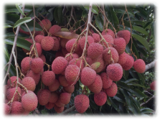
Main variety - Tai So
346 litchi orchards covering a total area of 423 ha
Fruit harvest season – early Nov. to early Jan.
Export market: 250 to 300 tonnes annually
Premium price for early season litchi
Shift from backyard to intensive system of production over last decade
Potential for regular bearing instead of every 2 yrs – through timely pruning, fertilization and irrigation
2017 ----- 70%

Slide 66
Climate Hazards the System might be exposed to
Cyclone
Heavy rainfall
Drought / extended dry spells
High temperature
Erratic rainfall

Slide 67
Adaptation Measures
POLICY
Soft loans
Freight rebate scheme (FRS)
MauriGap certification
Development of a supply chain for processed litchi products
Agricultural risk insurance

Slide 68
How do policy measures answer our goal?
Policy measures will provide the necessary financial support (compensation and incentives) to help growers of the cooperative to face extreme climatic events (e.g FRS)
MauriGap: Guarantee - Safe food and fetching premium litchi price i.e. higher grower income
Processing - Added value of litchi products for higher income and extended product availability to consumers

Slide 69
Adaptation Measures
TECHNICAL
Technical information dissemination (media, publication, SMS disease alert, Meteo, APMIS)
Pest and Disease Management
Timely fertilizer application

Slide 70
How do technical measures answer our goal?
Early warning system will contribute to decision making
Proper cultural practices, including timely fertilization will ensure annual fruit bearing and therefore contribute to sustained productivity

Slide 71
Adaptation Measures
RESEARCH
Introduction of new varieties
Extend the shelf-life for export
Decrease post-harvest losses

Slide 72
How do research measures answer our goal?
Introduction of early varieties to avoid the cyclonic season/heavy rainfall for a resilient system
Tolerance of varieties to high temperature, pest & disease for a greater fruit yield and revenue
Eco-friendly technology to extend the shelf-life of litchi products and extend period for product marketing

Slide 73
Adaptation Measures
CAPACITY BUILDING
Water management
Tree management
Agro-processing
Setting up of a model farm
Flower induction techniques

Slide 74
How do capacity building measures answer our goal?
Empower growers to improve flowering, fruit set, and quality product
Improve water use and fertilizer efficiency
Create opportunity for value addition through processing
Increase grower awareness about new production practices and increase production skills

Slide 75
Mitigation Potential
Reduction in GHG through:
The judicious use of fertilizers, and pesticides (IPM)
Mulching,
Increase in the carbon sink capacity (healthy canopy development),

Slide 76
“Tackling Climate Change in Agriculture: Approaches to Adaptation and Climate Smart Agriculture
Litchi Group
Keshav
Patricia
Satish
Yogeeta
Giantee
Rajiv
              22th June 2018
Thank you for your attention!

Slide 77
Q & A Litchi
Litchi is at high risk to climate hazards – it requires a multi-level approach
Measures implemented during the project could then also be scaled up to other areas of the island
Productivity focus of the measures, not clear where is the climate risk reduction of adaptation
  We are addressing the changes in rainfall by inducing flowering and giving farmers guidelines plus use of new varieties which can better deal with the climatic changes
  Introducing new varieties takes time, though – at least 6 years to have them productive
What would a climate smart litchi farm look like, and at what cost?
  We need the model farms to build farmer’s skills in more adapted litchi management
  Efficient fertiliser use, height of trees and spacing, girding to induce flowering, etc.
Gender sensitivity is key to projects – how many women are involved and what are the benefits for women?
  The president of the cooperatives is a lady
  25 members, 10 of them are women – in an orchard work load is less than in the field and women manage well – only putting the netting in place is a challenge
  Harvesting is done mainly through casual workers – sorting and packing as well
  Local buyers come to the orchard to buy in bulk. Exporters come at fruit setting to essentially ear mark which fruits/trees he will buy and he takes responsibility for the tree
  Bats and birds cause huge harvest losses - netting and wires with tent are placed to minimise bat invasions

Slide 78
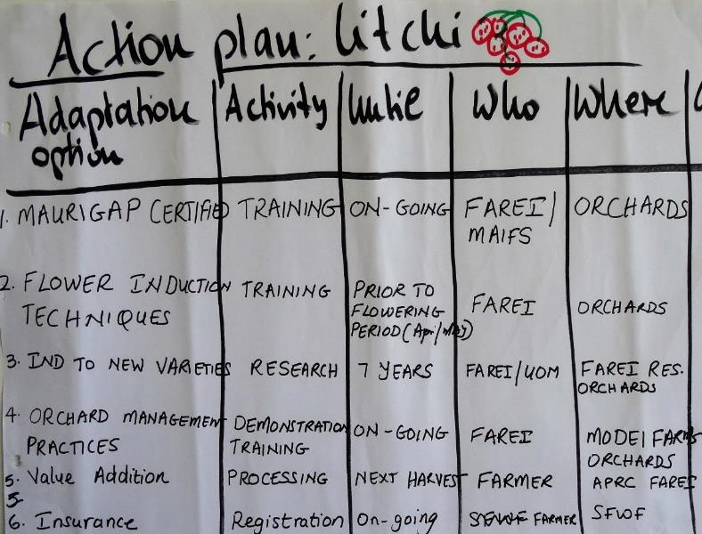
Action Plan Case 2: Litchi

Slide 79
Results Case 3
Tomato

Slide 80
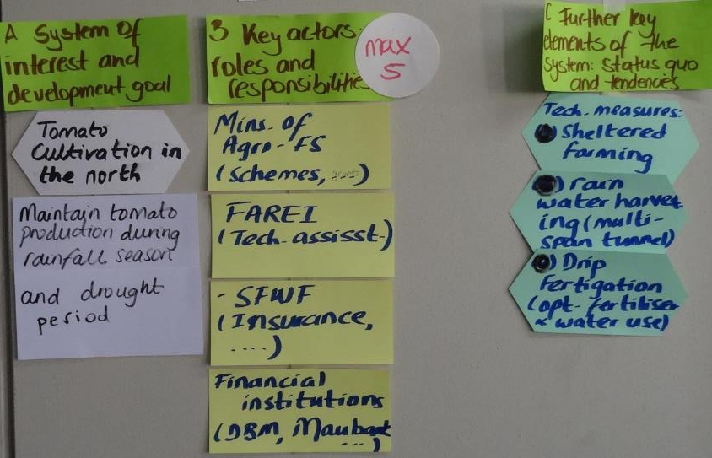
Module A.1 – current situation
Case 3: Tomato

Slide 81
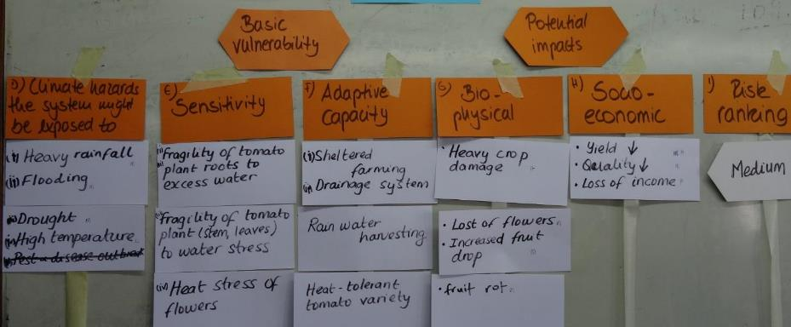
Module A.2 – future situation
Case 3: Tomato

Slide 82
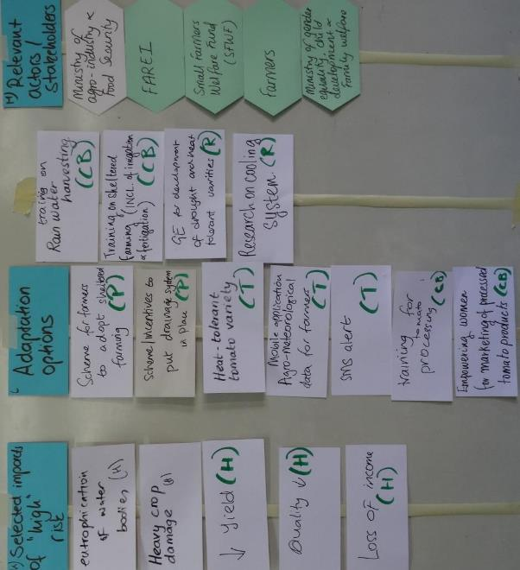
Module B - Case 3: Tomato

Slide 83
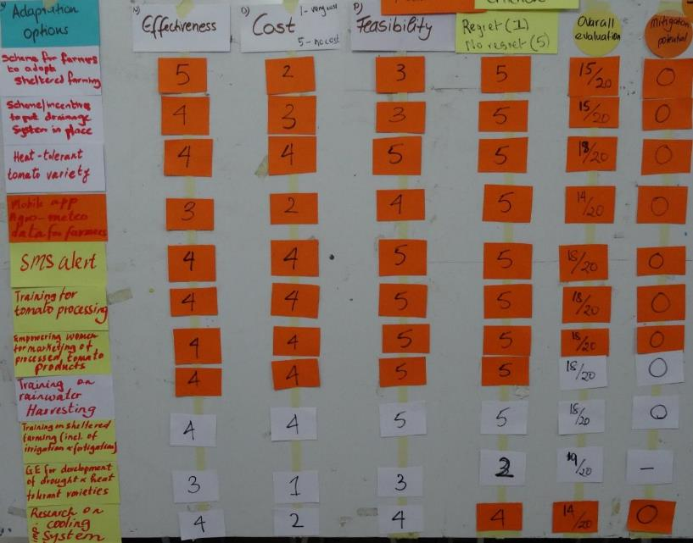
Module C - Case 3: Tomato

Slide 84
Presentation of final adaptation measures Tomato

Slide 85
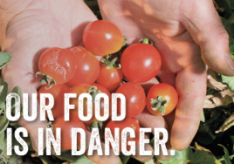

Case Study: Tomato
Tackling Climate Change Workshop
Case Study Group Presentation
22/6/18
By: Ram, Hudaa, Shemida, Julia, Gerard, Appadou
Notes:
Climate change is induced by increases in the atmospheric greenhouse gases concentration due to anthropogenic activities.
Climate change is affecting our agricultural production system. In particular, open-field tomato cultivation is likely to be vulnerable to effects of climate change.
Two main types of fresh tomatoes are grown in Mauritius viz. cooking and salad tomatoes. Main cooking tomato varieties grown in Mauritius are imported F1 Hybrid. During the past 3 years, the production level has declined by 24 % which is due to unfavourable climatic conditions.

Slide 86
What is our system of interest?
Open-field tomato cultivation in the North of Island of Mauritius
Notes:
Cooking tomatoes are mostly produced in the open field in Mauritius.
Tomato production has almost entirely remained the business of small-scale growers most of whom have plot sizes ranging from 1 to 2 acres.
The bulk of Tomato production is found in the northern part of the island, followed by the South. The most suitable soil types for tomato cultivation have been identified as being light, well drained fertile soils with a neutral or slightly acidic pH.

Slide 87
What is our development goal?
To maintain tomato production during rainfall season and drought period
Notes:
This crop is particularly sensitive to climatic offsets especially rainy and droughty periods resulting in a decrease in yield and the eventual shooting up of prices.

Slide 88
What are the climate hazards to which tomato cultivation in the North is exposed to?
Assessing the risk and defining the need for action
(i) Heavy rainfall
(ii) Flooding
(iii) Drought
(iv) High summer temperature
Notes:
High temperature : End of October until end of May
Drought period: End of October up to December, we often have on and off droughty conditions after that period
High rainfall: Late December to April/May

Slide 89
What are the high risk impacts on tomato cultivation in the North?
Biophysical damage:
  Leaching of nutrients to aquifers and water bodies
  Eutrophication of water bodies → Harmful algal blooms
  Heavy crop damage
  Impairment of tomato quality
Socio-economic damage
  Severe yield decrease
  Loss of farmers’ income

Slide 90
Can climate-smart agriculture approaches be adopted for the tomato crop?
Productivity
Mitigation
Adaptation

Slide 91
What are our adaptation options?
Policy
Technical
Capacity building
Research
Climate
adaptation
options

Slide 92
All possible adaptation options!
Policy | Scheme for farmers to adopt sheltered farming | Scheme/incentives to implement efficient drainage system in- field
Technical | Adoption of heat-tolerant variety of tomato by growers | Provision of an agro-meteorological mobile application for farmers | SMS (Short messaging Service) Alert
Capacity-building | Training on sheltered farming including sheltered structures, cultivation practices, irrigation and fertigation | Training on roof-top and surface rain-water harvesting | Training on tomato processing Empowering women for value-addition of tomato
Research | Genetic engineering to develop drought- and heat-tolerant tomato varieties | Research and development on smart cooling system

Slide 93
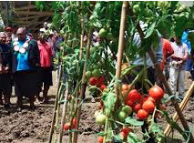
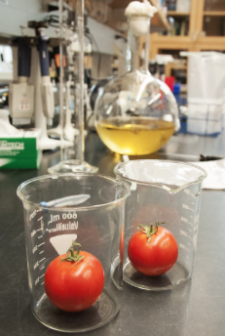

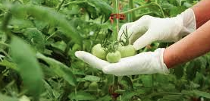
What are the best adaptation options for tomato cultivation in the North?

Slide 94
Short-listed adaptation options | Effectiveness | Cost | Feasibility | Regret/No regret | Overall evaluation | Mitigation potential (+/0/-)
Scheme for farmers to adopt sheltered farming | 5 | 2 | 3 | 5 | 15/20 | 0
Scheme/ incentives to implement drainage efficient system in fields | 4 | 3 | 3 | 5 | 15/20 | 0
Adoption of drought & heat-tolerant varieties | 4 | 4 | 5 | 5 | 18/20 | 0
SMS (Short messaging service) Alert | 4 | 4 | 5 | 5 | 18/20 | 0
Notes:
We have done a multi-criterion analysis and we think that the best options are:
(i) Scheme for farmers to adopt sheltered farming
The Government of Mauritius continues to support the sheltered farming scheme as indicated in Budget Speech 2018-2019. [50% grants from Govt and 50% from farmers/GCF]
(ii) Scheme/incentives to implement efficient in-field drainage system
The drainage system will assist in removing excess water or accumulated water in fields and requires civil works in terms of trenching. As a result, funding is being sought from GCF to implement the project.
(iii) Adoption of drought and heat-tolerant variety
Tomato flowers are susceptible to temperature rise and droughty conditions. Heat stress causes flower drop and a resultant decrease in fruit setting and yield. Funding is thus being sought for research and development in biotechnology to develop drought and heat tolerant varieties particularly suited to our climate.

Slide 95
Best adaptation options | Effectiveness | Cost | Feasibility | Regret/No regret | Overall evaluation | Mitigation potential (+/0/-)
Training on sheltered farming including cultivation practices, irrigation and fertigation | 4 | 4 | 5 | 5 | 18/20 | 0
Training on rain-water harvesting | 4 | 4 | 5 | 5 | 18/20 | 0
Training on tomato processing | 4 | 4 | 5 | 5 | 18/20 | 0
Empowering women for value-addition of tomato | 4 | 4 | 5 | 5 | 18/20 | 0
Notes:
(iv) Empowerment of farmers as a measure to build capacity for more resilience to CC. It is envisaged to carry out a full-fledged training that will consist of four modules (Sheltered farming, RW harvesting, tomato processing and marketing)
The training will require consultancy from giz to facilitate the transfer of knowledge pertaining to adaptive measures listed above and thus funding is being sought from GCF to cover the consultancy fee inclusive of hotels, airfare, venue, per diem and other logistical support.
There exists a possibility for using locally-produced tomatoes for processing and developing other value-added forms such as dehydrated, pickled, crystallised tomatoes. However, this will necessitate investment into appropriate processing plants and a re-organisation of the present production system to ensure sustainability through reliable, constant and adequate supply of the raw material. This possibility however requires due evaluation especially from the economic perspective.

Slide 96

So, why should GCF fund this project?
Climate change effects on our crop cultivation are unavoidable and already palpable!
Tomatoes feature among the four main foodcrops in Mauritius in terms of volume of supply on the local market.
Tomato cultivation is negatively affected by the following climatic variables: (i) precipitation and (ii) temperature
The main climatic hazards for tomato cultivation in the North are (i) heavy rainfall, (ii) flooding, (iii) drought and (iv) high temperature

Slide 97

So why should GCF fund this project?
In order to climate-proof tomato cultivation and maintain the same level of productivity under adverse climatic conditions, we need to invest in a multi-pronged adaptive approach
This four-pronged approach involves investing in technical measures and research, putting in place an enabling policy for tomato growers and building in capacity in all actors involved in the tomato value chain.

Slide 98
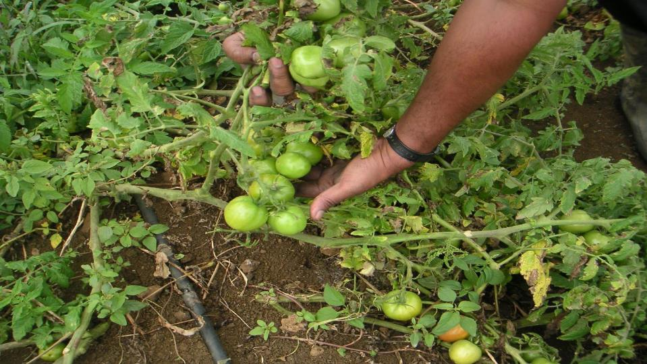
Thank you for
your attention

Slide 99
Q&A Final presentation
Tomato
Incentives here are tied to adopting certain practices – that is good, rather than just giving incentives with a goal (as in the lychee case)
Keen to see value for money – how many people with benefit
With drought and temperature tolerant varieties – would the mitigation potential not be positive? You use pesticides and fertiliser. ….
  No…..
Do we have the right varieties already?
  These varieties do not yet exist – they are not yet performing well enough in the field – these are still to be developed
SMS alert – meteorological data needs to be bought from the met services, FAREI already provides disease alerts, why not use that system
We already offer trainings in the way that you are suggesting, so what is new?
  We need to do this in a more timely manner

Slide 100
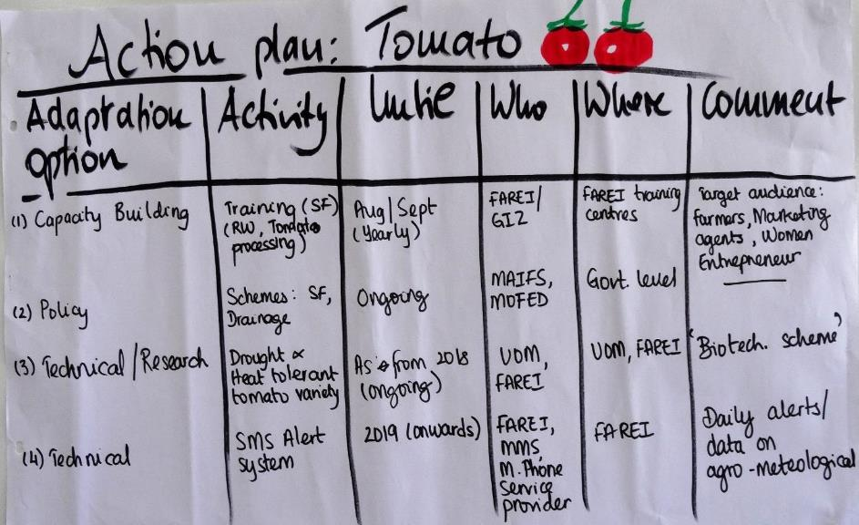
Action plan Case 3: Tomato

Slide 101
Reflecting the overall
Climate Proofing process by participants
In Module C more criteria can be introduced (e.g. gender or urgency) to proof the adaptation options
Positive effects could be emphasized during the Climate Proofing
More clarity on the mitigation potential was needed (e.g. do we focus on immediate measures or are we looking beyond?)
More information needed on “underutilized” crops esp. for their nutrition benefit
The multi-criteria analysis embeds a certain subjectivity → there are more tools to analyse options (cost-benefit and cost-efficiency-analysis)
How to manage different stakeholders in the CP process? The more perspectives you include, the better (multidisciplinary, from policy to farm-level)
Use “mitigation potential” as an additional criteria or give more rating levels? The criteria will also depend upon the development goal chosen for the system of interest
Include farmers and the policy level as participants in the course
Strong wish for networking of the CP Mauritius group (Facebook/WhatsApp)

Slide 102
Presentation 6: Climate change and marine environment by Dr. Satyam Bhoyroo, FoA
The presentation started with facts about climate change like the increasing global temperature and a map showing the surface temperatures of the world‘s oceans. The presenter then explained a map showing the average sea surface density. In dense regions, the surface water becomes dense enough to sink and joins the deep ocean currents (Thermohaline circulation). This circulation has a strong effect on the Earth's climate, influencing the Gulf Stream, El Niño events, and both past and future climate shifts.
Oceans remain the largest sink of CO₂ which leads to a phenomenon called ocean acidification. By the uptake of CO₂ from the atmosphere, the pH of the ocean decreases. Both, increasing ocean temperature and acidification have negative impacts on sea life (coral bleaching, decrease of zooplanktons, habitat of mangroves, algae bloom). These bio-physical impacts result in socio-economic ones like negative effects on aquaculture and on artisanal fisheries. The loss of mangroves has direct impact on coastal fisheries due to loss of breeding ground and nursery for reef fish, prawns and shrimps. Coral bleaching is a threat for 850 million people dependent on reef-based ecosystems for food security and livelihood. Close to 100 countries benefit from coastline protection, tourism and fisheries, supported by the biodiversity hosted by coral reefs. And a quarter of the 100 countries benefitting from coral reefs depend on tourism for more than 15% of their GDP.

Slide 103
Q&A
- Can we use artificial corals in our lagoons?
fish enjoy the new corals (food ground). Normally, corals need to grow in the best conditions, sensitive to temperature.

Slide 104
Presentation 7: Perception of CC by the Youth in Mauritius by Julia Carpouron, Student at the UoM
Julia presented the results of a survey undertaken by her and a team of UoM students on the perception of climate change by the youth in Mauritius. The primary goal of this research was to capture the understanding, views, beliefs, attitudes of the youth in Mauritius, and the action they take to tackle the impacts of climate change. 120 respondents aged between 13 and 25 years answered the questionnaire. 95.08% of the candidates acknowledged that climate change is happening. 77.05% showed an understanding of the term “climate change”, but only few identified CO₂ and other GHG as the main cause for CC. Knowledge on the impacts of climate change showed a weak positive correlation with age. Knowledge on the impacts of climate change showed no significant correlation with gender and academic qualification. Asked what they have done to reduce the impacts of CC, most of the respondents answered “nothing yet”. 11% are not aware of mitigation measures.
As a conclusion of this survey, Julia summed up that:
Mauritian youth is aware of the phenomenon of climate change
Pollution to be the main cause of Climate Change according to them
Lack of knowledge on mitigation measures

Slide 105
Day 3 – overview
Directly after the opening, Dr. Simbarashe Sibanda gave a presentation about “Nutrition-sensitive planning in agriculture under CC”
Subsequently, each of the working groups presented the results of the Module A. Questions and some corrections were made by the groups themselves and the facilitator.
This was followed by an action learning exercise in plenary about types and dimensions of adaptation options
The group then split into working groups again to work on Module B: identifying adaptation options
After the lunch break, the group started to their excursion to a sheltered farm in Plaine Magnien, close to Mahébourg airport, about an hours drive from the training venue.

Slide 106
Presentation 8: Nutrition-Sensitive Climate-Smart Agriculture (NSCSA) by Dr. Simba Sibanda, Food, Agriculture and Natural Resources Policy Analysis Network (FANRPAN)
Simba started with the definition of Food and Nutrition Security by the FAO: “Food and Nutrition Security exists when all people at all times have physical, social and economic access to food, which is safe and consumed in sufficient quantity and quality to meet their dietary needs and food preferences, and is supported by an environment of adequate sanitation, health services and care, allowing for a healthy and active life.”
He then gave examples of malnutrition and explained the triple burden of it (overweight & obesity, undernutrition and micro-nutrient deficiency). Malnutrition and diet are the biggest risk factors for the global burden of disease, responsible for over 70% of mortalities. Nutrition is central to achieve the Sustainable Development Goals (SDGs). At least 12 SDGs contain indicators that are highly relevant for nutrition. Improved nutrition has a positive impact on health, education, employment, female empowerment, and poverty and reduction of inequality.
Simba then explained the link between agriculture to food and nutrition security. Agriculture is fundamental to food production and the link to nutrition through food use via food availability and access is apparent (food production → food availability and access → diet food use). Nutrition-sensitive Agriculture is an approach that addresses disconnections between agriculture and nutrition, seeks to ensure the production of a variety of affordable, nutritious, culturally appropriate and safe foods, in adequate quantity and quality to meet the dietary requirements of populations in a sustainable manner. CC will have negative effects on global food supply, e.g. global agricultural production could fall by 2% per decade through 2050 and global food demand will be increasing by 14% each decade because of population growth, urbanization, and increased incomes. This calls for a the need for Nutrition-sensitive CSA: need to integrate nutrition into CSA, integrate the traditional objectives of agricultural development (production, productivity, food security and income) with nutrition. One can do this at various points along the agriculture value chain.

Slide 107
Q&A
We need to be careful about what we produce in Mauritius since we do not have much land
  We need to start looking at food systems which include looking at all processes required to meet food needs – Mauritius will never be food self-sufficient. Policy needs to provide guidance on what we should produce locally and what should be imported. E.g. fresh foods rather than staple. When we import, government needs to ensure that nutrition issues are also on the table when making decisions about what can be imported. There is a lot of power in regulation
Vegetables on display are always the same, we don’t have a lot of variety
  Some disagreement in the group about this statement
We should also give importance to food safety. We may have nutritious food but it is not safe
  That is why these two go together: we aim for nutritious and safe foods. Yes, food safety control is important and part of the health component of nutrition
Food we find on supermarket shelves are highly processed, we have a huge problem in Mauritius with this – on local production and imports. Consumer education is a huge issue, currently we accept what we have and this is not good.
  Yes, consumer education is strategic but long term, this is what will make companies change
  Globally FAO asked major companies to change what they produce in the next 3 years. Problem that global food companies are very powerful , there are only about 10 that produce the majority of our food. There is a huge potential though consumer choice to change things, especially with social media. But this requires investment in capacity development and awareness creation so that consumers can make effective demands for change.

Slide 108
Excursion to Plaine Magnien
Skills and Entrepreneurship Development Programme for Educated Youths
The project is an initiative of the Ministry of Agriculture aiming at modernisation of the local food crop production subsector as well as promotion of sustainable farming practices especially among younger segment of the population.
It comprises the setting up of a sheltered farming park on State Land at Plaine Magnien in the district of Grand Port. The whole park is intended to serve as facilities for promotion of sheltered farming systems and encourage, as well, venture of Mauritian youths in agricultural production as an economic activity.
The sheltered farming park comprises 10 modular units, covering each, a floor space of one thousand nine hundred and eighty-nine and seven-tenths square metres (1,989.7m2), equipped with irrigation / fertigation facility.
After an expression of interest and a selection process, the Ministry has enrolled, under the Programme, a group of nine Trainees and provided them with formal training in sheltered farming systems undertaken by the FAREI. Each Trainee has benefitted a modular unit within the park, where technical support and other handholding assistance are provided by the FAREI to enable them to undertake crop production activities on their own.
Training focused on adapted crops and production technologies (with emphasis on fertigation and vertical production) taking full advantages of the protected environment.
The conducive environment instilled during this incubation phase would expectedly see the Trainees gain skills and experience they need to create self-employment opportunities with decent revenue generation potential in the non-sugar agriculture subsector. Project is fully in operation as from early 2018 with the availability of irrigation water and electricity.
The Ministry is implementing the Programme jointly with the Food and Agricultural Research and Extension Institute (FAREI), in collaboration with the MyBiz and the Human Resource Development Council. The latter institution is funding the monthly stipend being provided to them.

Slide 109
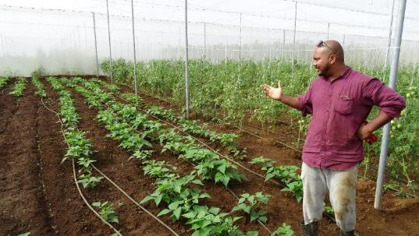
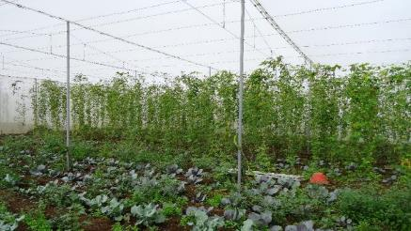
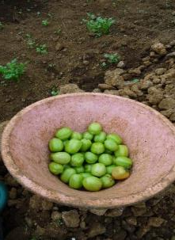
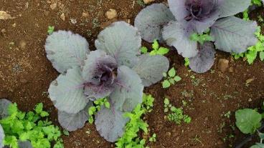
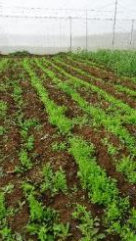
Impressions

Slide 110
Day 4 - overview
The day started with the recapitulation of the excursion within the plenary
This was followed by a presentation about “Strategies in sustainable intensification of livestock”
The group then split again in working groups to work on Module C: Selecting adaptation measures
Then a presentation on “Protected culture” was given
Afterwards, the working groups had time to prepare their final presentation on the climate proofing of the respective system of interest
A presentation about “CC with a value chain perspective” concluded the day

Slide 111
Recapitulation of the excursion – I
What are the climatic challenges for the sheltered farms at the site?
heavy rainfall and higher temperatures
2) How do these challenges influence the systems?
Water logging → death of plants
Higher temperatures → flower drops
Impact on human health
Pest and diseases
Higher yields for beans (indirect effect)

Slide 112
Recapitulation of the excursion – II
3) What kind of adaptation measures did you observe?
The shelter of the farm itself
Inter-cropping
Drainage system
Plants/herbs outside the shelter to attract plants
Vertical planting
Drip irrigation
Water storage
Adapted varieties
4) Where do you still see room for improvement?
Different shape of the roof (concave)
Use different building material (replace mesh)
Mesh on top to be replaced by a plastic roof (???)
Collect rain water on top of the mesh (cost implication needs to be analysed)
Mulching
Structure of the sheltered farming itself (is it really appropriate for Mauritius or maladaptation?)
Putting vertical nets to separate plant rows to avoid pest migrate from one row to the next
Install bee hives inside the sheltered farm
Improve the fertigation system

Slide 113
Presentation 9: Strategies in sustainable intensification of livestock production and its role in CSA by K. Boodhoo, FoA
The presentation started with background information on livestock - 70% of the world’s rural poor rely on livestock for their livelihoods. There are 600 million poor livestock keepers in the world, around 2/3 are rural women. 3 livestock production systems are differentiated: grazing systems, mixed systems and industrial systems.
Livestock contributes to 16 SDGs in terms of economic growth, equitable livelihoods, basic nutrition and health and sustainable ecosystems. But: animal production also has environmental impacts such as GHG emissions, nutrient excretion, land usage and energy expenditure through the use of fossil fuel. The speaker gave several examples on these impacts. He then linked CC dynamics to livestock production, explaining the manifold impacts on the systems. E.g. changes in rainfall impact on crop and pasture growth, water, pests and diseases. The presentation concluded with areas of interventions for climate-smart livestock practices and showed numerous strategies and potential for emission saving and adaptation measures.

Slide 114
Q&A
How to reduce carbon emissions from livestock systems?
Become vegetarian
It depends on the context – it is an important source of livelihood and animal protein in our part of the world, but definitely some parts of the world do need to reduce their meat consumption.

Slide 115
Presentation 10: Protected cultivation: an alternative for farmers to adapt to effects of
CC by Navindra Boodia, FoA
The presentation started with the definition of Protected Cultivation (or Sheltered Farming/SF), which is a cropping technique wherein the micro climate surrounding the plant canopy is controlled partially or fully as per the requirement of the crop species. Six types of protected structures can be differentiated: mini cloches, mini tunnels, low tunnels, high tunnels shade house and insect-proof net house. These structures differ in the level of climate control that they confer, the degree of sophistication and in the costs. In Mauritius, farmers are encouraged to shift from traditional open field cultivation to sheltered farming system. 50% of investment costs (up to max. Rs 250,000) is granted.
Amongst the advantages of SF are: protection against winds, minimize the impact of heavy rain, prevent soil erosion, reduce leachates to the soil environment, reduced usage of crop protection chemicals.
Siting and design considerations have to be taken into account. Constraints for farming in the tropics are for example intense heavy rainfall (flash flood), storm, strong winds, insect pests, high daytime temperature. This results in a need for special requirements for tropical SF. Most of these have to do with the site selection and design features: covering materials, GH orientation & structural materials and set-up. For a site selection one has to avoid marshy land and flood-prone areas. A region with established drainage systems should be chosen as well as land that slopes down to nearby canals. Natural wind-breaks are positive, but shading trees need to be avoided.
The speaker then elaborated more on the technical details of the structures and the materials. In context of CSA, SF can serve as a means to implement biological control, water harvesting and organic farming.

Slide 116
Presentation 11: CC in agriculture with a value chain perspective by Dr. Brinda Ramasawmy, FoA
Brinda started her presentation with the definition of a value chain (VC): the path by which a product or service is created and marketed. This path might include input suppliers, growers, transport and storage, processors, wholesalers, retailers and consumers, as well as governance and support institutions. Agri-food VCs are critical systems for delivering food security, contribute significantly to economic stability and add to consumer confidence. The impacts of CC are felt along the whole chain of actors that produce, handle, process and market agri-food products. Adaptation of a VC to CC is therefor key to sustain its competitive advantage in a changing climate. An adapted value chain is one where participating businesses, from farmers to retailers, are able to harness joint strategies to continue delivering value to the consumer, and as such, deliver value to the members of its chain. The speaker then presented two case studies on adaptation of VCs. She then brought up some research questions for the Mauritian context, namely:
- Are we taking a holistic approach to CC adaptation and mitigation by taking a whole-of-chain perspective?
- Are we considering CC impact on the agricultural sector only as a threat or as an opportunity to produce adapted products?
- Are we focusing our research at the farming level only and ignoring the flow-on effects across the agri-food VC?
- Do agri-businesses adapting to or mitigating CC factors take into consideration the needs of consumers? She then showed potential objectives to promote adapted Mauritian agri-food VCs:
To increase capability of businesses to take effective adaptation action through awareness of the impacts of CC on VCs,
To increase awareness of new and relevant adaptation and mitigation options available for businesses to consider within their VCs,
To enhance the capacity of agrifood businesses to collaboratively evaluate and adapt to the impacts of CC.

Slide 117
Q&A
I was thinking about the way we buy food – focus is on buying healthy food. For the consumer to go into adaptive products – are they aware of the climate impacts on the value chain? How can we improve this in the local context?
  It comes down to consumer purchasing power – it is an issue in Mauritius – the richer consumers can afford to buy organic, healthy or other foods. We are putting emphasis on price, not quality. Consumers will say that they would buy the products if they have more money
  Consumer education is important – more money does not mean consumers choose to invest in healthy or adapted food. They might buy a new TV instead
  For electronic products, consumers buy energy efficient products – and it works for health consciousness to some extent
  Not clear how adapted products will directly benefit the consumer
  We could also have consumer contribute a small premium to support certain farming systems
Companies change for their image – getting consumers to change takes time
Mauritius’ import regulations are not restrictive and we import all the processed foods – what are we feeding to our population is problematic

Slide 118
Day 5 - overview
After the opening the first group held their final presentation.
Before the 2nd and 3rd final presentation, a PowerPoint presentation on “Carbon footprint in agriculture” was given.
After each presentation of the final adaptation measures, questions were asked by the audience and the results discussed.
This was followed by a reflection and conclusions of the CP approach – what did you learn, how can you apply CP in your own work?
Each group then drafted an Action plan with adaption measures, activities, a time frame and responsibilities to implement the selected measures.
The presentation part ended with Wiebke giving an overview of CCARDESA‘s Information, Communication and Knowledge Managment
The training ended with the evaluation and hand over of certificates and USB sticks to each participant

Slide 119
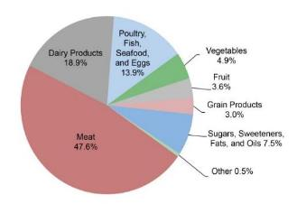
Presentation 12: Carbon footprint in agriculture by Prof. B. Lalljee, FoA
A carbon footprint is the recording of total GHG emissions (both direct and indirect) caused by an individual, event, organisation, or product, expressed as carbon dioxide equivalent (CO_{e}). Carbon footprints are used as a direct measure of the quantum of gases emitted into the atmosphere causing CC.
The Agriculture, Forestry and Other Land Use (AFOLU) sector contributes about 25% of human-generated GHG emissions, mainly from deforestation and agricultural emissions from livestock, soil and nutrient management. Reducing agriculture’s carbon footprint is central to limiting CC. Moving to sustainable agricultural practices will play a key role in limiting global warming to no more than 2˚C.
Methods of calculating the Carbon Footprint:
The traditional way of estimating a carbon footprint – so-called 'lifecycle assessment' – involves adding up as many of the emissions pathways as is feasible.
An alternative approach is to use so-called 'input-output' analysis. This aims to avoid missing out pathways by taking the total emissions of a country or region, dividing it into relevant sectors, and estimating the total emissions that each sector accounts for. Those figures can then be used to estimate the footprint of, say, each rupee spent in each activity in each sector.
GHGs from average
food consumption
The presenter concluded with some CSA practices for reducing the carbon footprint.

Slide 120
Q&A
Landscape approaches – and many institutions do things but not coordinated – how do we move to a results, how do we better coordinate?
FAO is funding a regional CSA centre in Mauritius which should bring the different sectors together – we need a cross-institutional focal point
  Here, we also have more freedom in the system – there is not that much staff turnover and we work closely together already

Slide 121
Presentation 13: CCARDESA’s ICKM System by Dr. Wiebke Förch, GIZ
Wiebke gave an overview on CCARDESA‘s main objectives, being the broker for regional knowledge dissemination on CSA. She then presented the key websites of CCARDESA‘s Information, Communication and Knowledge Management (ICKM) system. Further she explained to the audience how they can benefit and invited them to participate in the network.
The relevant websites are:
http://saaiks.net
www.facebook.com/ccardesa
www.twitter.com/ccardesaa
CCARDESA D-groups to join the D-Groups, please send an email to: dgroups@ccardesa.org
www.ccardesa.org
The contact person in Mauritius is:
Mr Chandrabose Sembhoo
Food and Agricultural Research and Extension Institute (FAREI)
Email: sembhoo@gmail.com

Slide 122
Final feedback round on how far the expectations of the participants were met - I
Expectation of CC and diseases – that was my misunderstanding – happy about the things I heard about though
Expectation of tools for planning, how to proceed – was expecting more technical detail of adopting detailed practices and technologies – but what I got was new and more at a planning level – so I can use my new skills for proposals
Wanted to learn about CC and how we can help farmers to adapt – that was fully met
Learn about CC and agriculture – that was well fulfilled, it was an opportunity to also discuss with each other / also wanted to learn about tools – this was met through the CP tool – overall, I got motivation to learn more and access additional resources
Thanks for your time and energy – it was good to meet other players in Mauritius and exchange. I had expected to learn about CS concepts, crop management and analytical tools – I am happy to learn that a lot of good practices that we are already using or promoting are already in line with the CS concept. We learnt how to use a CP tool with all its strengths and weaknesses – and we can adapt the tool to our respective context and improve our own tools and processes. I will take it back to my colleagues
Very enriching experience, my first workshop, get to know our local experts and other players in the country. My expectation was to understand CC in agriculture – this was fulfilled. I am happy that I can apply the CP tool also to my work in aquatic systems. That is more than I expected
The didactic of the training was very new and it was a very good way to learn new things. I had expected computer modelling. I was keen on sugar cane, but we got other crops. Overall very happy though.

Slide 123
Final feedback round on how far the expectations of the participants were met - II
Thank you! I wanted to know about adaptation and mitigation measures in agriculture – my expectation was met. I will use them in preparation for training materials for farmers. I will start with CSA materials next week.
Thank you. Expected to gain information about mitigation based on other experiences. My expectations was met. The CP tool was very good. It will help me in my research work
Expected to improve my knowledge to pass on to farmers. On Monday I have a meeting on CSA with farmers involved with the Ministry – so this will be a continuous action in my work. I also get called to participate in policy. Thank you, this will help me a lot. Thanks to all, it was fun!
Expect to learn about mitigation and learn about new technologies for adaptation. This was met. The sheltered farming was also very good. I will apply this in my work
Expected to improve knowledge about practices and what others are doing. I learnt some. But I was interested also in use of renewable energy in agriculture. Not much. But I was impressed with the method of teaching – easy to grasp and the knowledge stays with us. We have learnt to be more focused on climate hazards and how we can improve our work and be more focused
I learnt a lot – coming from a completely different background
Expected to gain practical knowledge and tools – I am happy that you shared an approach that can guide us in our thinking and our work. A tool that will help us to be focused, down to earth and broken down into pieces that are easy to understand. I was expected to get tools – but I had to do this myself. It has helped me to look at the basics and I will bring that into my work in the sugar cane sector. I liked the interactive and enriching approach

Slide 124
Final feedback round on how far the expectations of the participants were met - III
Coming from marine science, I just wanted to learn about CC in agriculture. so I learned a lot about agriculture and about CC. it was really interesting. We had fun with this group of people.
Expected to get new knowledge and how to face CC – I had been so focused on soil management and other things and a lot of new things have enriched my mind. I am more conscious how to adapt and take my new knowledge. The CP has impressed me – leading us to a solution. It was the first time in my many workshops that I got something useful out of it.
Expected to get new tools that are practical, innovative and sustainable – I learnt many things in this group, the quality of people who excellent. The way the training was delivered was nice to the ear, easy to follow, no stress on the eye. Everywhere we go we usually get bombarded with PPT. See, my friend even brought a pillow ;-). Everyone noted the level of satisfaction with the course in the feedback. We have learned a lot and will excel! Thank you.
Expected to discuss barriers to adaptation and mitigation – we discussed all this. But I would have had other expectations if I knew more about the course. The training was very useful, we knew only the topic in a haphazard way. Now we can position our knowledge clearer in our teaching. I enjoyed the action learning, it is hard to do in class but it is a good way to impart knowledge. We did not discuss the barriers fully. But in general I am very happy! We are all more sensitive to CC impacts now and will reflect on our behaviour
Special thanks to all the presenters from the university to share their expertise
Now it is up to us to apply our knowledge in our own personal and professional context – we can now take ownership and change our behaviour to be mindful of our carbon footprint….
Catalina: I wanted to learn and work in a relaxed atmosphere. It was super working with you. You took a lot of burden off, everything was understood quickly and you were very organised, saving time, nice discussions in groups and in plenary. We managed with the facilities. I learnt a lot about agriculture in Mauritius.

Slide 125
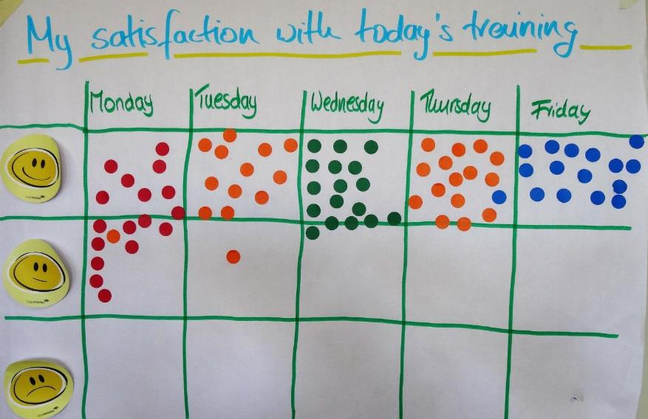
  Daily evaluation

Slide 126
For further information
www.ccardesa.org
www.africacsa.org
www.fao.org/gacsa/en
http://saaiks.net
www.wocat.net
www.agriwaterpedia.info
www.fao.org/climate-smart-agriculture/en
www.adaptationcommunity.net
www.cip.csag.utc.ac.za
https://csa-guide.ccafs.cgiar.org
Join-climate-l@lists.iisd.ca
www.worldbank.org (then search for climate change knowledge portal)
Tools for measuring sustainability on a farm:
Self-evaluation and Holistic Assessment of climate Resilience of farmers and Pastoralists (SHARP)
http://www.fao.org/in-action/sharp/en/
RISE – getting sustainability down to earth
https://www.hafl.bfh.ch/en/research-consulting-services/agricultural-science/sustainability-and-ecosystems/sustainability-assessment/rise.html
Sustainability Assessment of Food and Agriculture systems (SAFA)
http://www.fao.org/nr/sustainability/sustainability-assessments-safa/en/

Slide 127
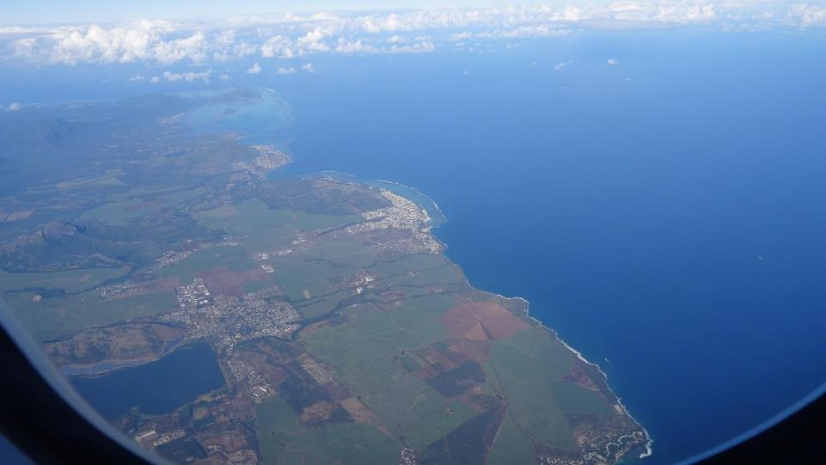
Thank you!!!

