Slide 1



3rd Biennial Review (BR) Performance Report of AUC on the Implementation of Malabo Declaration
CCARDESA CAADP XP4 PROGRAMME
MALABO IMPLEMENTATION STATUS IN SOUTHERN AND EASTERN AFRICA
20 – 22 September 2022
Gaborone, Botswana
Martin T. Muchero
International Consultant
pamusha12@gmail.com +267 7422 9647

Slide 2
PRESENTATION OUTLINE
Overall Score Card
Overview of SADC Performance
Overview of EAC Performance

Slide 3
MALABO STATUS OVERALL SCORED CARD

Slide 4
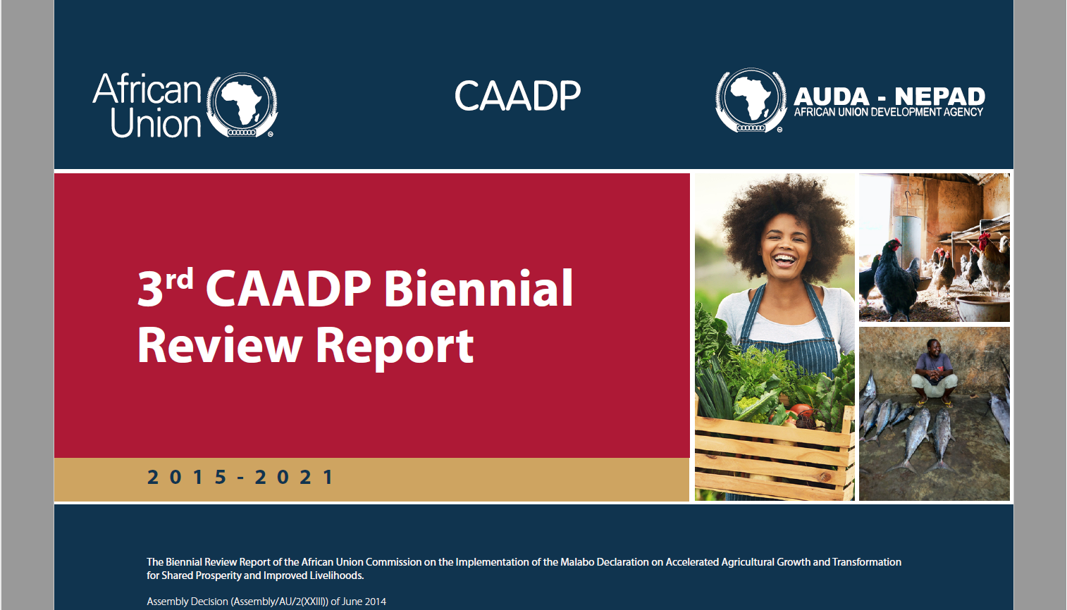

Slide 5
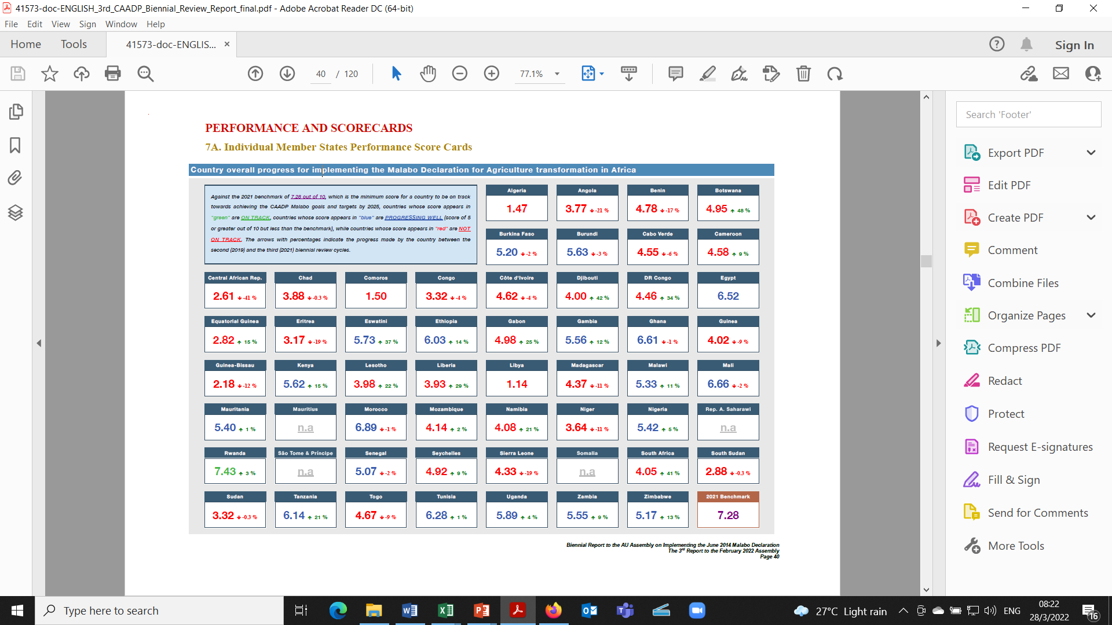
















3rd Biennial Malabo Declaration Score Card

Slide 6
MALABO STATUS – OVERALL SOUTHERN AFRICA REGION

Slide 7
3rd Biennial Malabo Declaration – Summary Status for Southern Africa
Southern Africa
This region has twelve (12) Member States namely: Angola, Botswana, Lesotho, Madagascar, Malawi, Mauritius, Mozambique, Namibia, South Africa, Eswatini, Zambia and Zimbabwe. Under the joint coordination of SADC and COMESA.
The overall average score for the region is 4.11, which indicates that the region is not on-track in meeting the CAADP/ Malabo commitments when assessed against the 7.28 benchmark for 2020.
This also represents a 3.5% decline in performance when compared to the 2019 BR for the bloc. Among the eleven (11) Member States, none is on-track which represents a 66.7% decrease from the number of Member States that were on-track in the inaugural BR but represents no change from the 2019 BR.

Slide 8
3rd Biennial Malabo Declaration – Summary Status for Southern Africa
Southern Africa
Southern Africa, as a region, is not on-track in any of the seven Malabo commitments in the 2021 BR. Whereas it was on-track on four commitments in the inaugural BR, it was also not on-track on any of the commitments in the 2019 BR.
The Member States with relatively good agricultural data management systems produced better reports for the Biennial Review process.
Aligning and implementing policies and programs based on CAADP principles contributed to better performance of the Member States (meeting the biennial targets set in the Malabo/CAADP process and agriculture sector performance) as depicted by the fact that five (5) Member States (Zimbabwe, Zambia, Mozambique, Malawi, Botswana) are on-track with respect to implementing the CAADP Process indicator.

Slide 9
3rd Biennial Malabo Declaration – Summary Status for Southern Africa
Southern Africa
Considering the low performance in Eradicating Poverty through Agriculture, investment finance in agriculture and ending hunger, the region needs to consider the following
  (1) firstly, it should increase public expenditure to agriculture;
  (2) then increase farmers’ access to agriculture inputs and technologies.
The region should also:
  (1) Enhance investment in resilience building, invest in post-harvest storage technology to limit post-harvest loss;
  (2) Strengthen agricultural data collection and management systems to ensure that all Malabo Declarations goals and targets are reported on in future;
  (3) Work to attract more and high quality public and private investments in the agriculture sector that improve and sustain the performance of the agriculture sector for ending hunger and poverty reduction;
  (4) Foster domestication of the Malabo Declaration and targets into their NAIPs.

Slide 10

MALABO STATUS – OVERALL EASTERN AFRICA REGION

Slide 11
3rd Biennial Malabo Declaration – Summary Status for Eastern Africa
Eastern Africa
This region is composed of 13 Member States, namely: Burundi, Comoros, Djibouti, Eritrea, Ethiopia, Kenya, Rwanda, Seychelles, Somalia, South Sudan, Sudan, Tanzania, and Uganda.
The region is coordinated jointly by the East African Community (EAC), the Intergovernmental Authority on Development (IGAD), and the Common Market for Eastern and Southern Africa (COMESA).
Overall, the region achieved a score of 4.56, well below the 2020 benchmark of 7.28. Only one country, Rwanda with a score of 7.43, is on track to meet the Malabo Commitments.

Slide 12
3rd Biennial Malabo Declaration – Summary Status for Eastern Africa
Eastern Africa
Similar to the Second Biennial Review cycle, the Eastern Africa region is not-on-track to meet any of the seven Malabo Commitment areas. The region needs to pay critical attention to all commitment areas if it is to meet the Malabo Declaration targets by 2025.
The region needs to pay particular attention to the commitment on enhancing investment finance in agriculture in which it has not even achieved the halfway mark when assessed against the 2020 benchmark.
Unlike the Second Biennial Review cycle, the region was also not-on-track in any one of the performance categories of the seven commitment areas.

Slide 13
3rd Biennial Malabo Declaration – Summary Status for Eastern Africa
Eastern Africa
When assessed against the 2020 benchmarks, the region performed particularly poorly in:
  Promoting access to and use of financial services by smallholder farmers;
  Promoting utilization of cost-effective & quality agricultural inputs including improved crop seeds as well as livestock and fishery inputs, irrigation and mechanization to boost agricultural productivity;
  Promoting initiatives to improve nutritional status of children and women and food security;
  Sustaining agriculture sector growth by ensuring higher contribution to GDP and to poverty reduction;
  Promoting initiatives that facilitate preferential entry and participation for women in gainful and attractive agri-business opportunities;
  Promoting intra-African trade in agriculture commodities and services.
Notwithstanding the overall poor performance, it is worth noting that the region has made good progress in embracing the CAADP process, including establishing mutual accountability mechanisms and enhancing resilience to climate variability and other shocks.

Slide 14

Thank You
Re-aleboga
Sunset Picture by Martin T. Muchero
Lubombo Transfrontier Conservation Area – Eswatini (June 2021)

